Slide 1
Programming in C
© 2005 Devendra Tewari

Slide 2
Objectives
Learn the core elements of ANSI C
Get to know tools for building C programs on GNU/Linux
Learn to read and debug C programs
Build useful utilities for reusing in your own programs

Slide 3
Introduction

Slide 4
History
Originally designed and implemented by Dennis Ritchie on DEC PDP-11 [1]
Influenced by B [2] written by Ken Thompson in 1970
First C standard in 1988 by ANSI (C89)
Adopted by ISO in 1990 (C90)
Most recent standard C99 by ISO [3]
Compiled language
Source code portable

Slide 5
C program – hello.c
#include <stdio.h>
/* function main - print hello world */
int
main()
{
printf("hello world!\n");
return 0;
}

Slide 6
C program structure
Multi-line comments begin with /* and end with */, these are called delimiters
# is used to begin pre-processor directives
Execution of a C program begins at function main
main can return an int value to the operating system otherwise it should return void
Code blocks and function bodies begin with { and end with }
C statements end with ;

Slide 7
Executing hello.c
Use GCC [4]
gcc hello.c -o hello -Wall
Without the o option the executable is a.out
Execute
./hello
Output
hello world!

Slide 8
Compilation process
A compiler produces the executable by performing through the following steps
Pre-processing
Compilation and assembly
Linking

Slide 9
Pre-processing
Conceptual first step in compilation
Two tasks commonly performed
File inclusion
#include directive
#include <stdio.h>
Macro substitution
#define directive
#define pf printf
pf("hello world!")

Slide 10
Compilation and assembly
Lexical and semantic analysis to generate intermediate code
Transform the intermediate code to assembly or machine code
Creating an object file using GCC
gcc hello.c -c
The c option tells GCC to not perform linking
A file called hello.o is produced

Slide 11
Linking
Linking combines all the object files and required library code to produce a single executable
gcc hello.o -o hello

Slide 12
Multiple source files – hello.c
#include "print.h"
/* Function main - Print hello world */
int
main()
{
print_hello("hello world!\n");
}

Slide 13
Multiple source files – print.c
#include <stdio.h>
#include "print.h"
void print_hello(char * str)
{
printf("printing: %s", str);
}

Slide 14
Multiple source files – print.h
#ifndef _PRINT_H_
#define _PRINT_H_
extern void print_hello();
#endif //_PRINT_H_
#ifndef - #endif sequence above serves to guarantee that the pre-processor does not include the same header file twice in a source file.

Slide 15
Simple compilation
Executing gcc
gcc hello.c print.c -o hello
Executing hello
./hello
Output
printing: hello world!

Slide 16
Complex Compilation- An Error
hello.c
gcc hello.c -c
produces hello.o
print.c
gcc print.c -c
produces print.o
Error?
gcc hello.o -o hello
hello.o(.text+0x27):hello.c: undefined reference to `_print_hello'
collect2: ld returned 1 exit status

Slide 17
Complex Compilation – Correcting the Error
Using gcc
gcc hello.o print.o -o hello
Using ld [5] (gcc with -v switch shows how)
ld -o hello /lib/crt0.o -L/opt/gcc.3.3/lib/gcc-lib/i586-pc-interix3/3.3 hello.o print.o -lgcc -lc -lpsxdll -v
/opt/gcc.3.3/lib/gcc-lib/i586-pc-interix3/3.3 is the path to libgcc.a in my Windows SFU installation

Slide 18
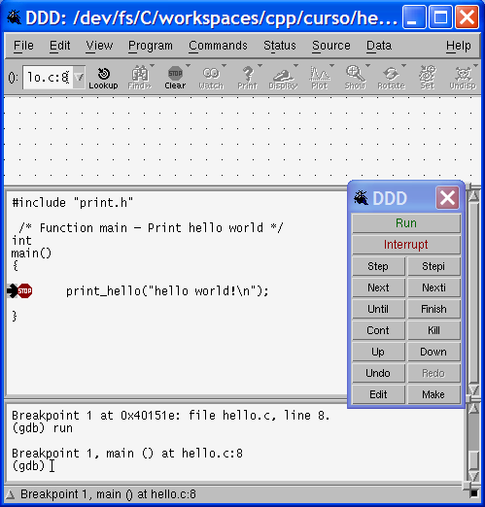
Debug Using DDD
DDD is a graphical debugger for X Windows and it uses gdb, the command line debugger
Re-compile source code with extra debug information for gdb
gcc hello.c print.c -o hello –g
Execute ddd
ddd hello
Try stepping through code and adding watch expressions

Slide 19
Other Topics
Creating static and shared libraries [6]
Dynamic linking
GCC compile, link and optimize options
Building applications with make
Using Eclipse and CDT [7] for C/C++ development

Slide 20
References
The Development of the C Language - http://cm.bell-labs.com/cm/cs/who/dmr/chist.html
THE PROGRAMMING LANGUAGE B - http://cm.bell-labs.com/cm/cs/who/dmr/bintro.html
JTC1/SC22/WG14 - C - http://www.open-std.org/jtc1/sc22/wg14/
GCC - http://gcc.gnu.org/
GNU Binutils - http://www.gnu.org/software/binutils/
Shared vs static libraries - http://www.linuxselfhelp.com/HOWTO/GCC-HOWTO/x575.html
Eclipse CDT - http://www.eclipse.org/cdt/

